Slide 1
Binary Tree Traversal
Lecture #
By: Abdul Aleem

Slide 2




Contents
1
Binary Tree Traversal Techniques
2
Preorder Traversal
3
Postorder Traversal
4
Inorder Traversal
5
Level Order Traversal
6
Construction of Tree from Traversal

Slide 3
Binary Tree Traversal Techniques
Often we wish to process a binary tree by “visiting” each of its nodes, each time performing a specific action such as printing the contents of the node.
Any process for visiting all of the nodes in some order is called a
traversal.
Any traversal that lists every node in the tree exactly once is called an enumeration of the tree’s nodes.
There are four different ways to traverse a Binary Tree:
1
2
3
4
Preorder Traversal Postorder Traversal Inorder Traversal Level Order Traversal

Slide 4
Preorder Traversal
In a preorder traversal, each root node is visited before its left and right subtrees are traversed.
Preorder traversal is also called backtracking.
The steps for traversing a binary tree in preorder traversal are::
1
2
3
Visit the root.
Visit the left subtree, using preorder. Visit the right subtree, using preorder.
The algorithm for preorder traversal is as follows:
preorderTraversal(TreeNode root) { if (root == null)
return; print(root.data);
preorderTraversal(root.left);
preorderTraversal(root.right);
}

Slide 5
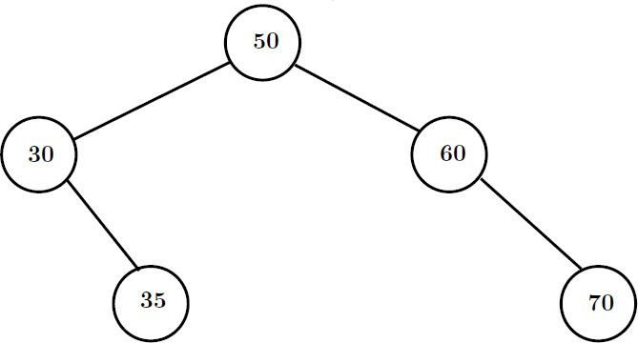
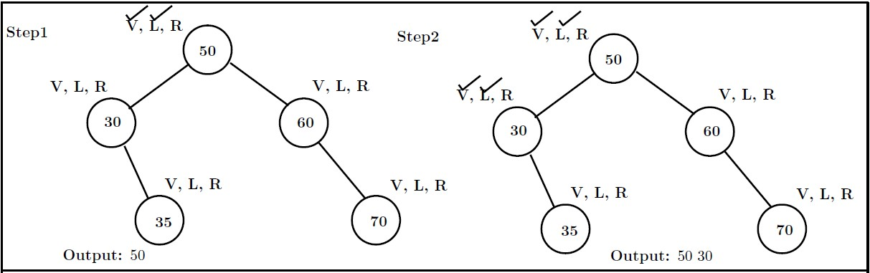
Preorder Traversal
Problem : Traverse the following tree in preorder.
Solution :

Slide 6
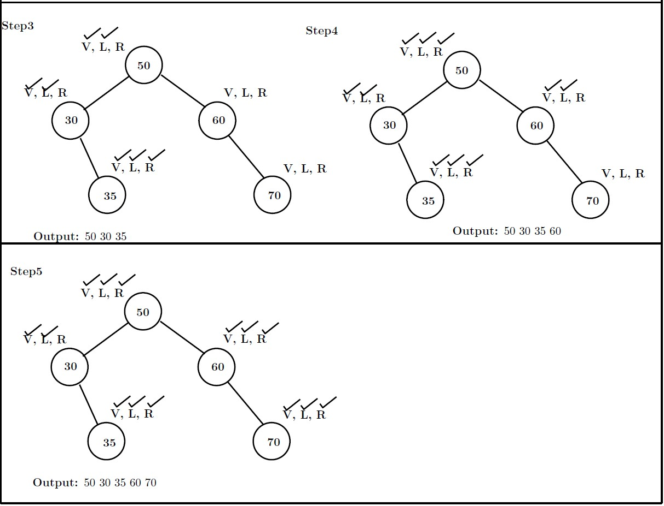
Preorder Traversal

Slide 7
Postorder Traversal
In a postorder traversal, each root is visited after its left and right subtrees have been traversed.
The steps for traversing a binary tree in postorder traversal are:
1
2
3
Visit the left subtree, using postorder. Visit the right subtree, using postorder. Visit the root.
The algorithm for postorder traversal is as follows:
postorderTraversal(TreeNode root) { if (root == null)
return; postorderTraversal(root.left); postorderTraversal(root.right); print(root.data);
}

Slide 8
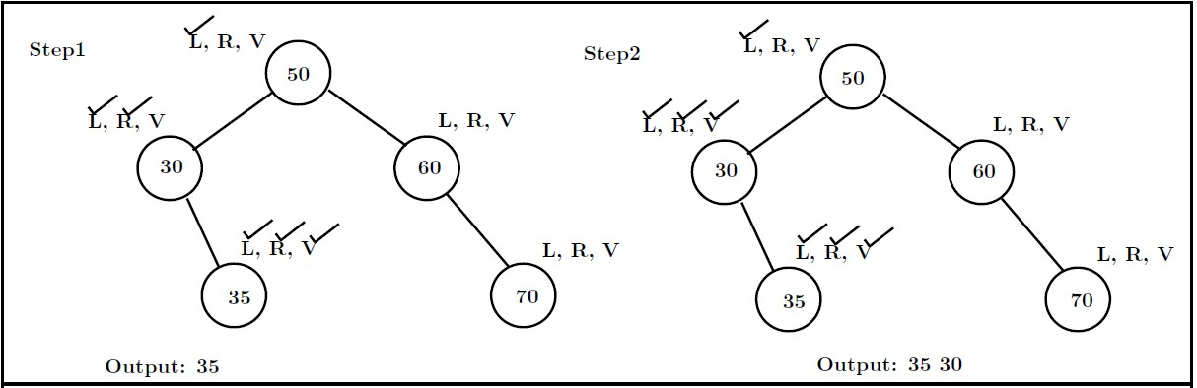
Postorder Traversal
Problem : Traverse the following tree in postorder.
Solution :

Slide 9
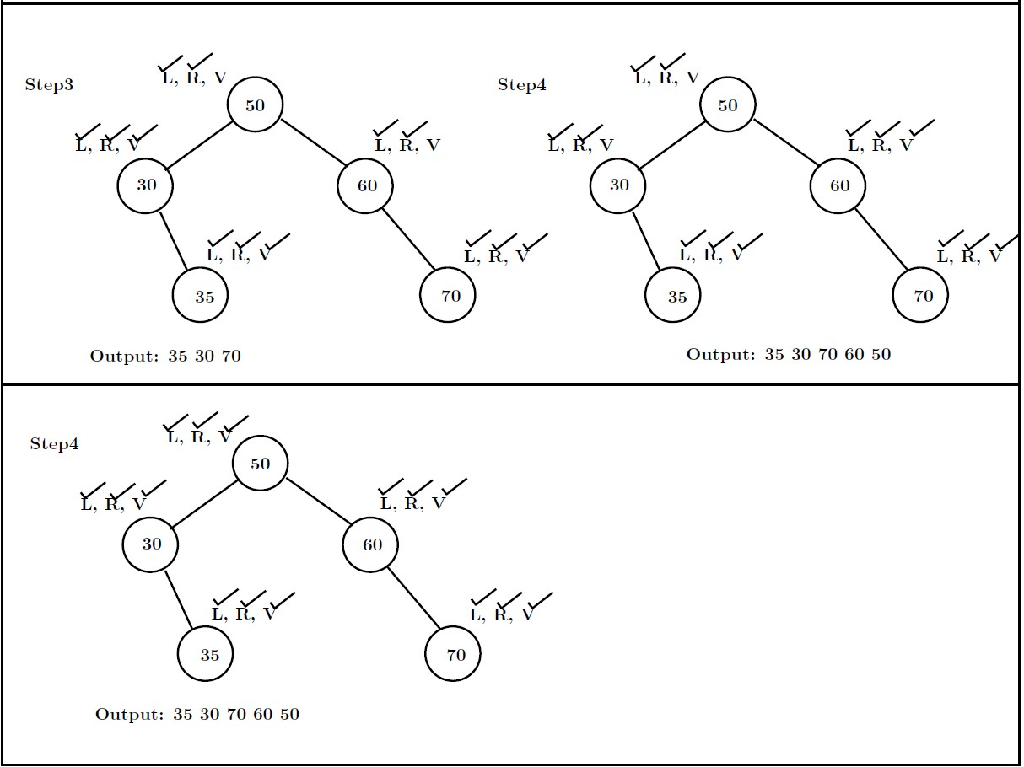
Postorder Traversal

Slide 10
Inorder Traversal
In the case of inorder traversal, the root of each subtree is visited after its left subtree has been traversed but before the traversal of its right subtree begins.
The steps for traversing a binary tree in inorder traversal are:
1
2
3
Visit the left subtree, using inorder. Visit the root.
Visit the right subtree, using inorder.
The algorithm for inorder traversal is as follows:
inorderTraversal(TreeNode root) { if (root == null)
return; inorderTraversal(root.left); print(root.data); inorderTraversal(root.right);
}

Slide 11
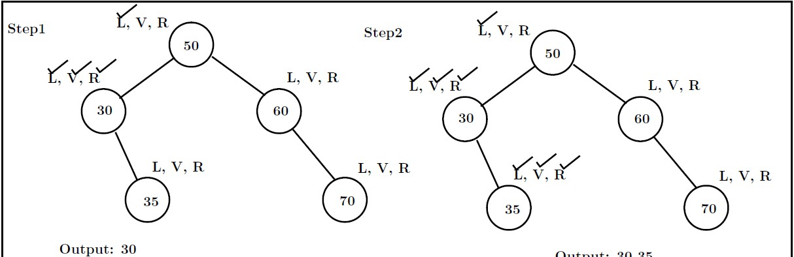
Inorder Traversal
Problem : Traverse the following tree in inorder.
Solution :

Slide 12
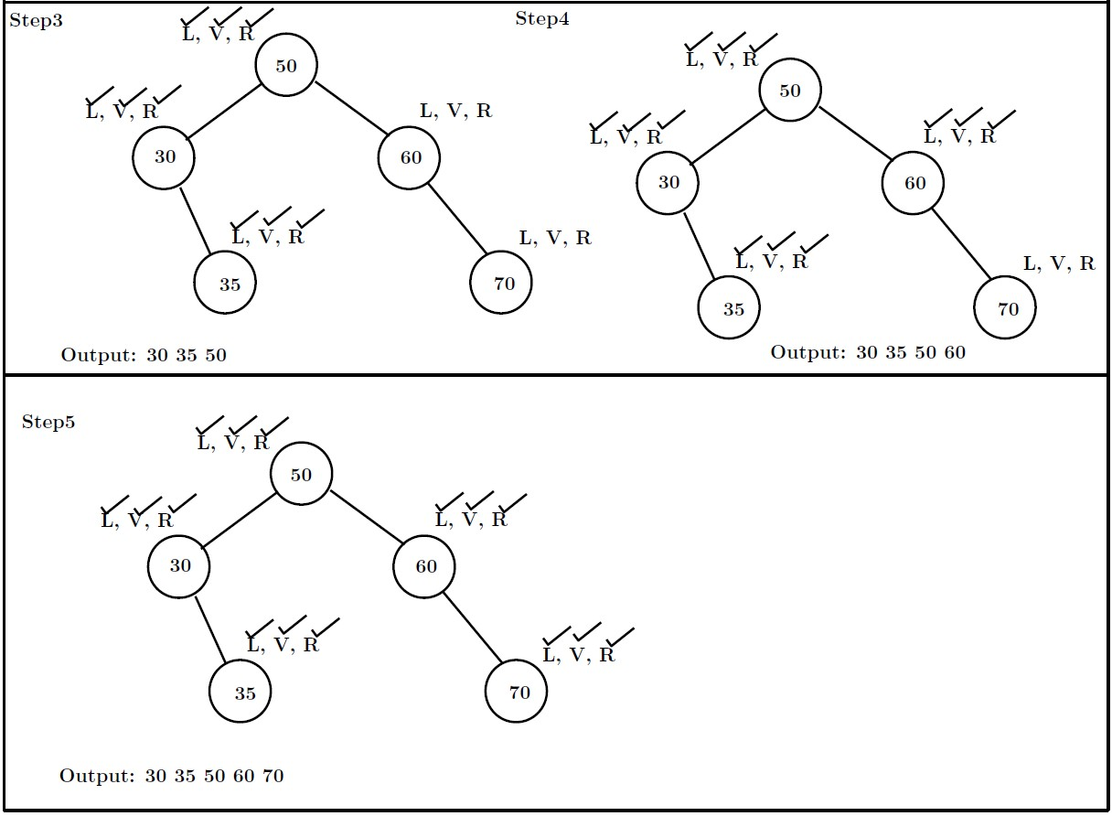
Inorder Traversal

Slide 13
Level Order Traversal
In a level order traversal, the nodes are visited level by level starting from the root, and going from left to right.
This also known as breadth first search (BFS) approach. The level order traversal requires a queue data structure.
When we process a node, we’ll push the node’s children onto the end of the queue in the order in which we want to traverse (in this case, left to right).
In this way, we’ll have finished putting the next row in the queue at the same time we finish iterating through this row.

Slide 14
Level Order Traversal
Problem : Traverse the following tree in level order.
Output : 50, 30, 60, 35 ,70

Slide 15
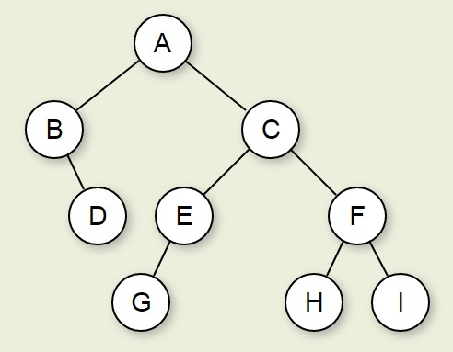
Question on Traversal
Problem : Traverse the following tree in Preorder, Postorder, Inorder and level order.

Slide 16
Construction of Tree from Traversal
Sometimes it is required to construct a binary tree if its traversals are known.
From a single traversal it is not possible to construct unique binary tree.
However any of the two traversals are given then the corresponding tree can be drawn uniquely:
1
2
3
Inorder and preorder Inorder and postorder Inorder and level order

Slide 17
Construction Process
If the preorder traversal is given, then the first node is the root node.
If the postorder traversal is given then the last node is the root node.
Once the root node is identified, all the nodes in the left subtrees and right subtrees of the root node can be identified using inorder.
Same technique can be applied repeatedly to form sub-trees.
It can be noted that, for the purpose mentioned, two traversal are essential out of which one should be inorder traversal.
Alternatively, given preorder and postorder traversals, binary tree cannot be obtained uniquely.

Slide 18
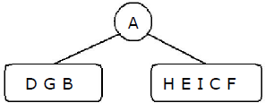
Example
Problem : Construct a binary tree from a given preorder and inorder sequence:.
Preorder: A B D G C E H I F Inorder: D G B A H E I C F Solution :
From Preorder sequence A B D G C E H I F, the root is: A
From Inorder sequence D G B A H E I C F, we get the left and right sub trees:
Left sub tree is: D G B Right sub tree is: H E I C F
The Binary tree upto this point looks like:

Slide 19
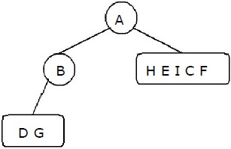
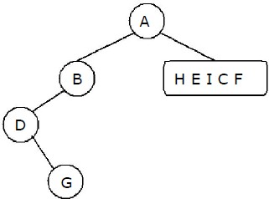
Example
From the preorder sequence B D G, the root of tree is: B
From the inorder sequence D G B, we can find that D and G are to the left of B.
From the preorder sequence D G, the root of the tree is: D
From the inorder sequence D G, we can find that there is no left node to D and G is at the right of D.

Slide 20
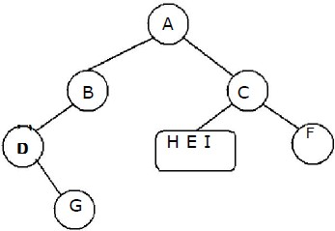
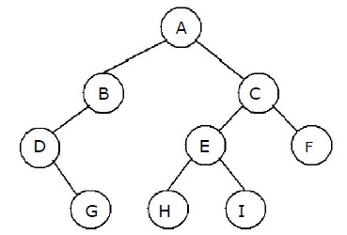
Example
From the preorder sequence C E H I F, the root of the left sub tree is: C From the inorder sequence H E I C F, we can find that H E I are at the left of C and F is at the right of C.
From the preorder sequence E H I, the root of the tree is: E
From the inorder sequence H E I, we can find that H is at the left of E and I is at the right of E.

Slide 21
Example
Problem : Construct a binary tree from a given postorder and inorder sequence.
Inorder: D G B A H E I C F Postorder: G D B H I E F C A Solution :
From Postorder sequence G D B H I E F C A, the root is: A
From Inorder sequence D G B A H E I C F, we get the left and right subtrees:
Left sub tree is: D G B Right sub tree is: H E I C F
The Binary tree up to this point looks like:

Slide 22
Example
From the postorder sequence G D B, the root of tree is: B
From the inorder sequence D G B, we can find that D G are to the left of B and there is no right subtree for B.
From the postorder sequence G D, the root of the tree is: D
From the inorder sequence D G, we can find that is no left subtree for D and G is to the right of D.

Slide 23
Example
From the postorder sequence H I E F C, the root of left subtree is: C From the inorder sequence H E I C F, we can find that H E I are at the left of C and F is at the right of C.
From the postorder sequence H I E, the root of the tree is: E
From the inorder sequence H E I, we can find that H is at the left of E and I is at the right of E.

Slide 24
Question
Problem : Construct a binary tree from a given postorder and inorder sequence.
Inorder: 4, 2, 1, 7, 5, 8, 3, 6
Postorder: 4, 2, 7, 8, 5, 6, 3, 1
Problem : Construct a binary tree from a given preorder and inorder sequence.
Inorder: 4, 2, 5, 1, 6, 3, 7
Preorder: 1, 2, 4, 5, 3, 6, 7

Slide 25
[1] Goodrich and Tamassia ‘Data Structures and Algorithms in java ’, Wiley, India.
References

